Slide 1
Online GPS II/MAPP
Meetings 1 – 10

Slide 2
Meeting 8 Understanding the Impact of Fostering and Adopting

Slide 3
License Rights to OCFS
Center for Development of Human Services, Institute for Community Health Promotion, SUNY Buffalo State acknowledges the State of New York’s and the Office of Children and Family Services’ royalty-free, non-exclusive and revocable license to reproduce, publish, distribute, or otherwise use any and all material herein for the limited purpose of training GPSII/MAPP Leaders and for as long as such materials and such training are deemed appropriate by NYS OCFS.
The Children’s Alliance of Kansas (CAOK) is the current national owner of the copyrighted “toolbox” of MAPP programs. NYS Office of Children and Family Services (NYS OCFS)/Center for Development of Human Services (CDHS) has permission from CAOK to provide MAPP programs (GPSII/MAPP, Caring For Our Own, Deciding Together, Shared Parenting, Mini-MAPP, and Child Sexual Abuse) to certify leaders through leader certification workshops and directly to foster/adoptive parents in New York State.
In order to better meet the needs of children and families in New York State, PS-MAPP was revised in 2004 and renamed GPSII/MAPP. Further revisions were made in 2005 after considering the feedback from MAPP Leaders throughout the state, and minor revisions and reformatting occurred in 2009. Significant revisions to the content and updating to reflect best practice and legal changes in New York State were made and approved by NYS OCFS in 2012 for this edition.
© 2009 Children’s Alliance of Kansas. Revised with permission NYS OCFS.

Slide 4
Rules of the Road
Placeholder

Slide 5
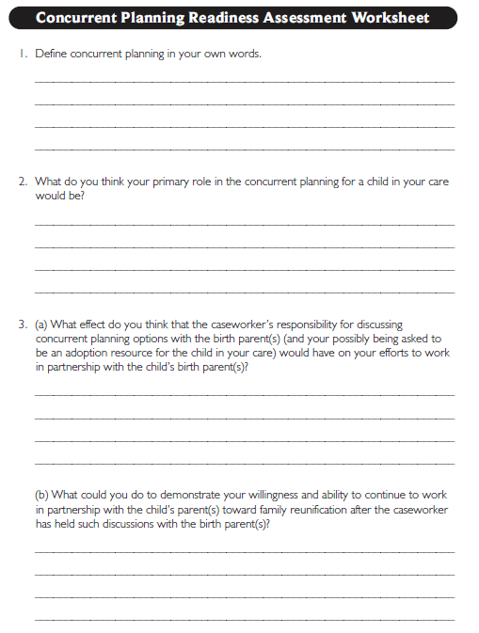
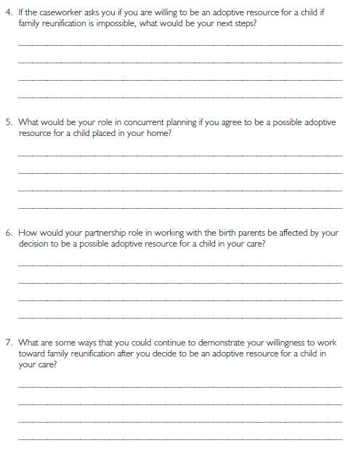
Roadwork from Last Meeting: Meeting 7 Handout 18, Concurrent Planning Readiness Assessment Worksheet

Slide 6
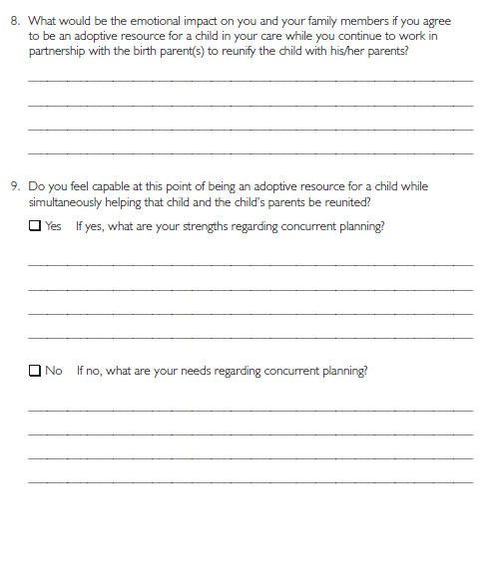

Slide 7
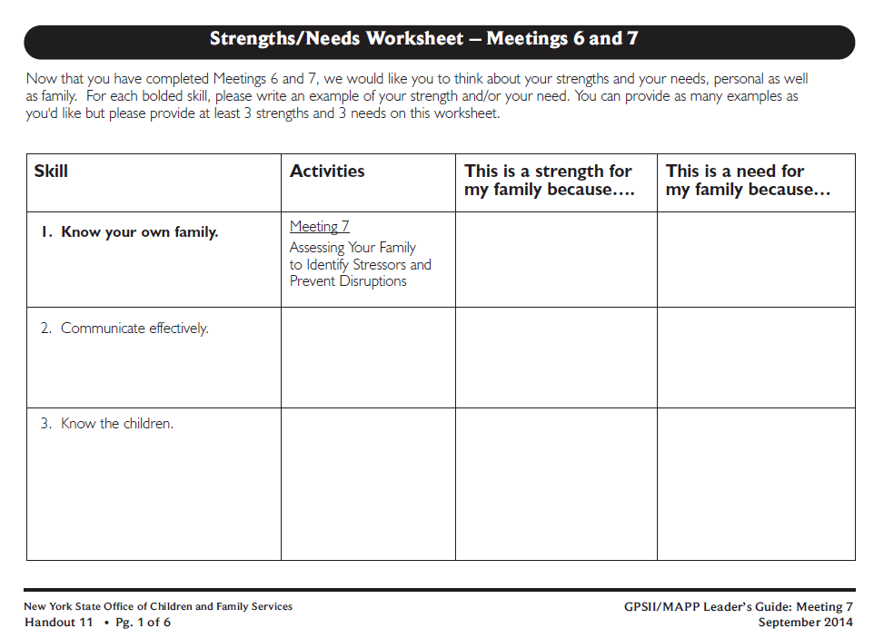
Roadwork from Last Meeting:
Meeting 7 Handout 11, Strengths/Needs Worksheet

Slide 8
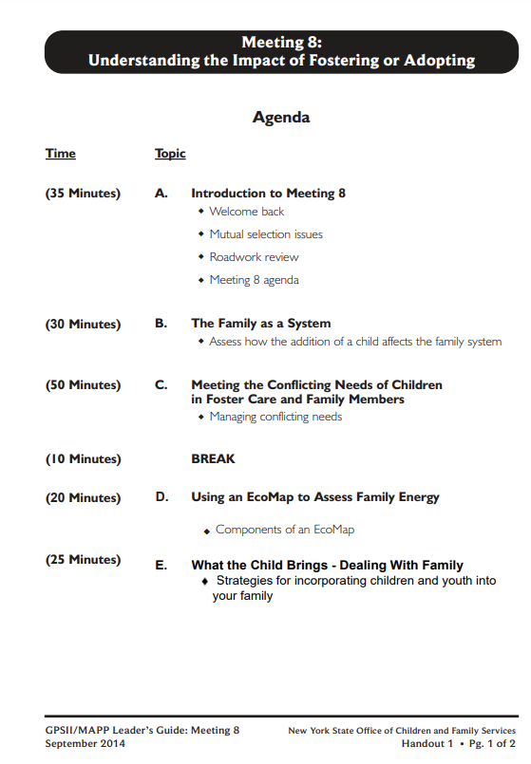
Let’s look at: Handout 1

Slide 9
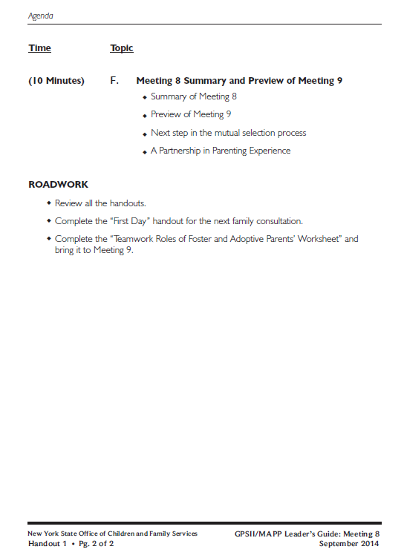

Slide 10
How would you define family?

Slide 11
What social changes have affected family life in our country in recent years?

Slide 12
Definition of System
A regularly interacting or interdependent group of items forming a unified whole.

Slide 13
A change in one family member affects the whole family
Example:
One parent changes from the night shift to the day shift

Slide 14
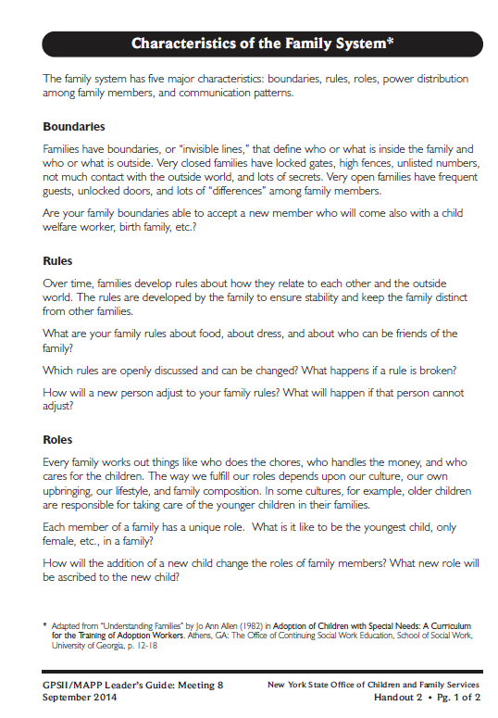
Let’s look at: Handout 2

Slide 16
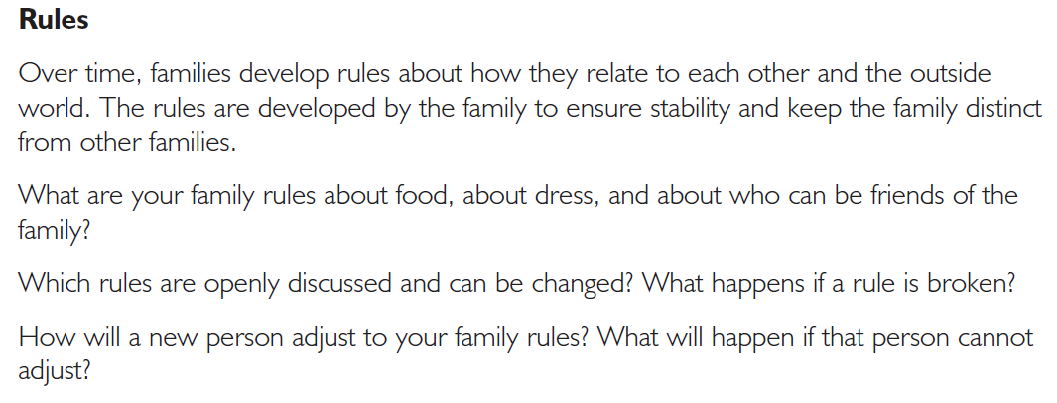

Slide 17
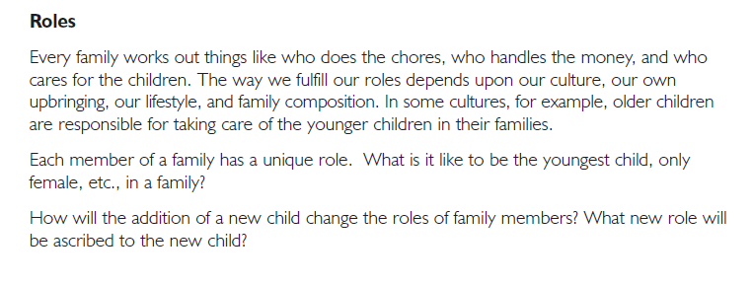

Slide 18
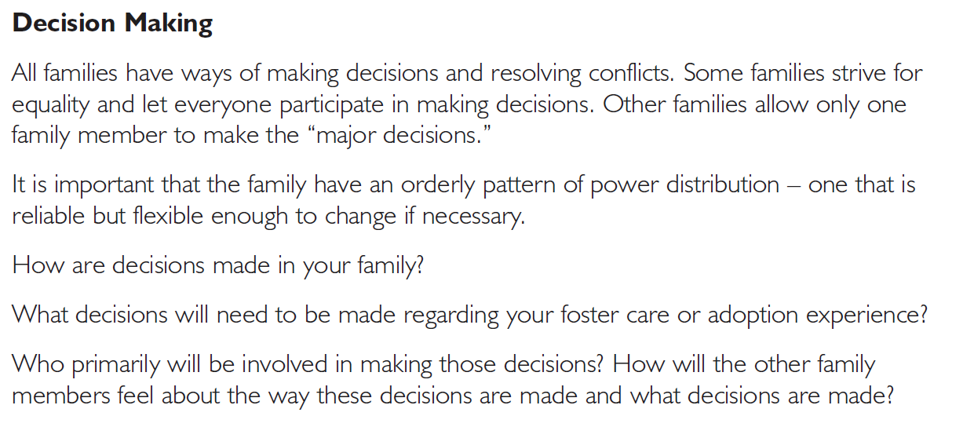

Slide 20
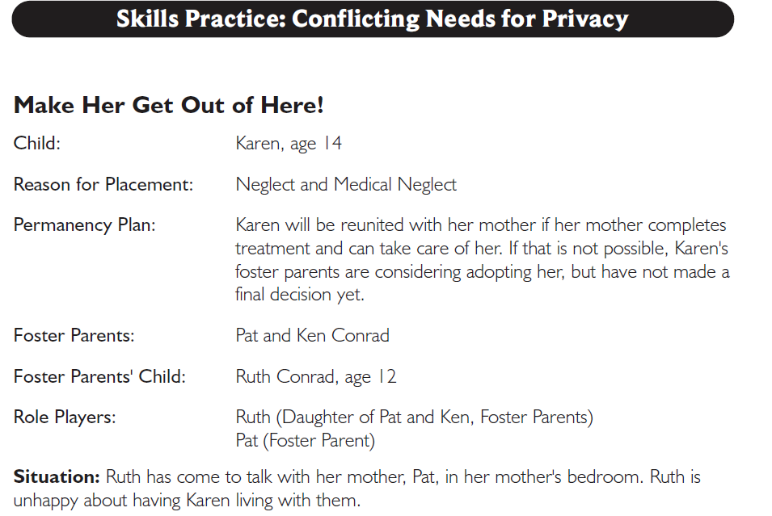
Let’s look at: Handout 3

Slide 21
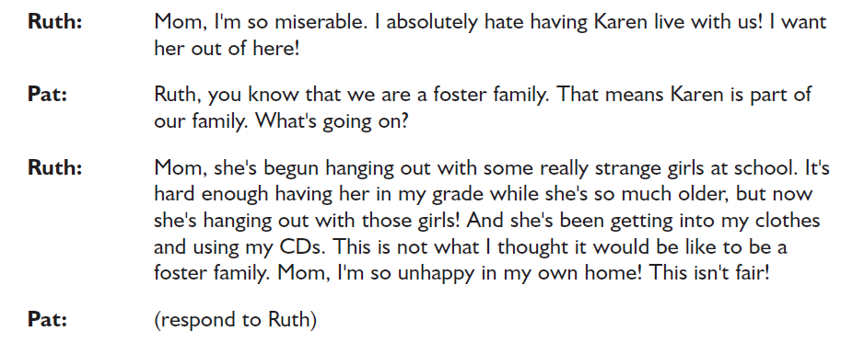

Slide 22
Handout 3 Process Questions
Pat: What is one emotion you are feeling?
Ruth: What is one emotion you are feeling?
Group: What is one emotion you are feeling?
Pat: What do you think you did well?
Ruth: What did your mom say or do that was helpful?
Group: What did Pat say or do that was helpful to Ruth?
Pat: What might you do differently next time?
Ruth: What do you wish Pat would do different next time?
Group: If you were Pat, what else might you say or do?

Slide 23
Conflicting Needs for Privacy
What challenges would a similar situation create in your family?

Slide 24
Let’s look at: Handout 4

Slide 25
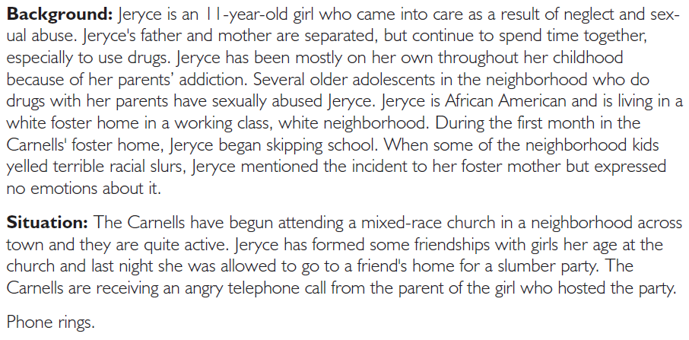

Slide 26
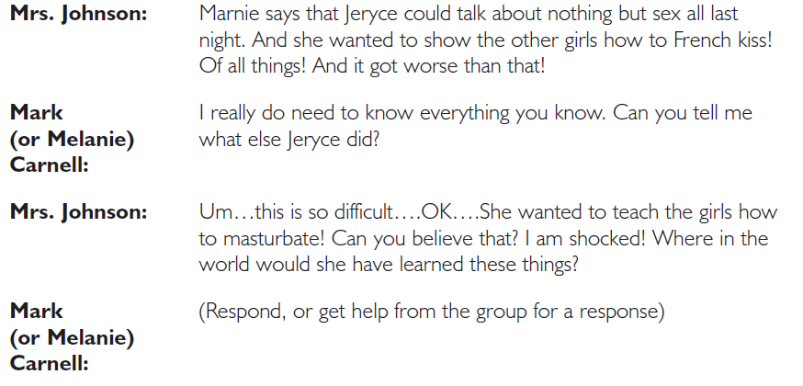

Slide 27
Handout 4 Process Questions
Foster Parent: What is one emotion you are feeling?
Mrs. Johnson: What is one emotion you are feeling?
Group: What is one emotion you are feeling?
Foster Parent: What do you think you did well?
Mrs. Johnson: What did the foster parent say or do that was helpful? Group: What did foster parent say or do well?
Foster Parent: What might you do differently next time?
Mrs. Johnson: What else do you wish the foster parent would say
or do?
Group: If you were the foster parent, what else might you say or do?

Slide 28
Confidentiality
What challenges can confidentiality regarding children in care and their families create for your family?

Slide 29
Agency Confidentiality Policy
Placeholder

Slide 30
Let’s look at: Handout 6

Slide 31
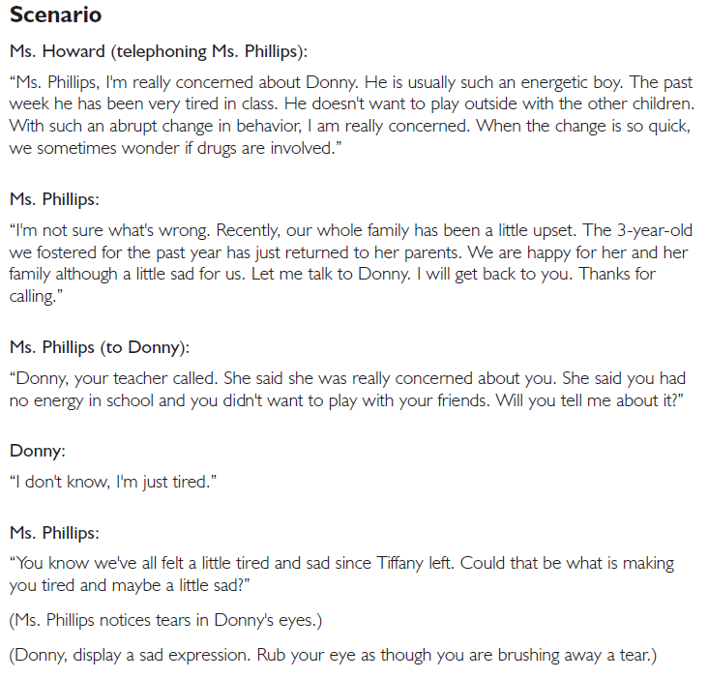

Slide 32
Handout 6 Process Questions
Foster Parent: What is one emotion you are feeling?
Donny: What is one emotion you are feeling?
Ms. Howard: What is one emotion you are feeling?
Group: What is one emotion you are feeling?
Foster Parent: What would have helped you deal with this situation?
Donny: What would have helped you in this situation?
Group: How would you describe the attachment or emotional connection between Donny and Tiffany?

Slide 33
Let’s look at: Handout 7

Slide 34
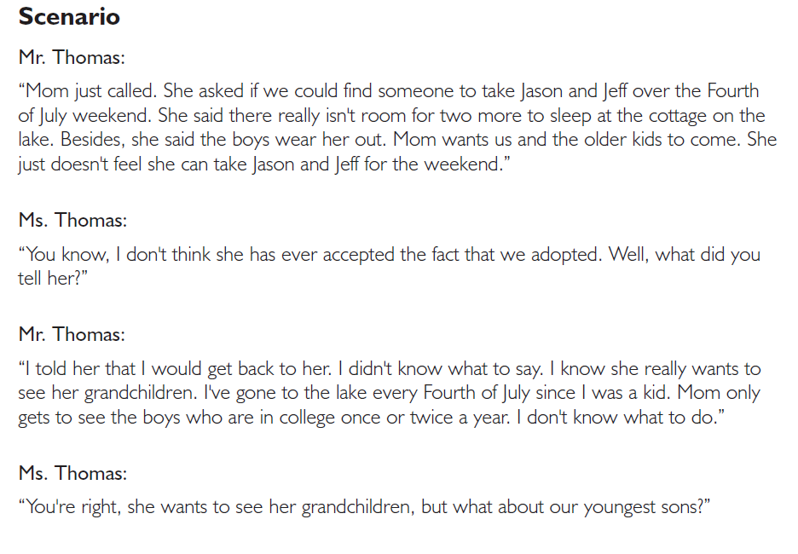

Slide 35
Handout 7 Process Questions
Ms. Thomas: What is one emotion you are feeling?
Mr. Thomas: What is one emotion you are feeling?
Group: What are some possible solutions to this problem?

Slide 36
Handout 7 Process Questions (continued)
Group:
How might this situation affect the Thomas’ relationship?
How might this situation affect Ms. Thomas’ relationship with her mother-in-law?
How might the older boys feel?
Could this situation occur in your family?
How could this situation have been prevented?

Slide 37
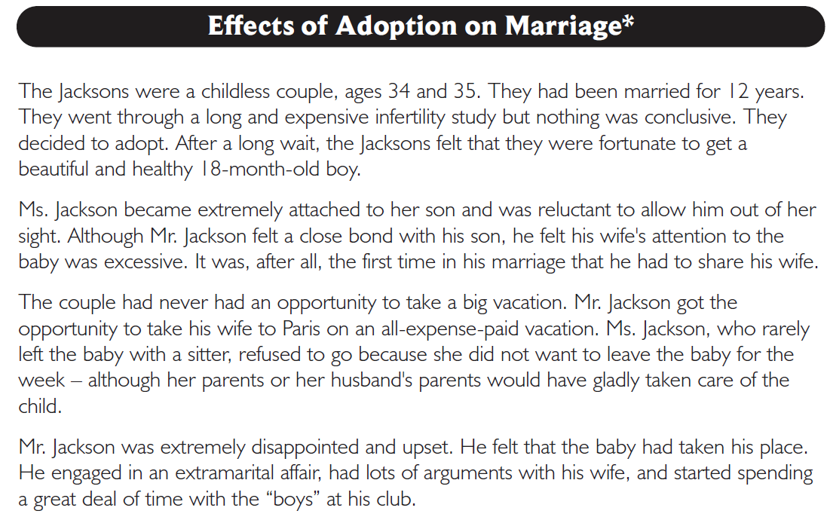
Let’s look at: Handout 8

Slide 38
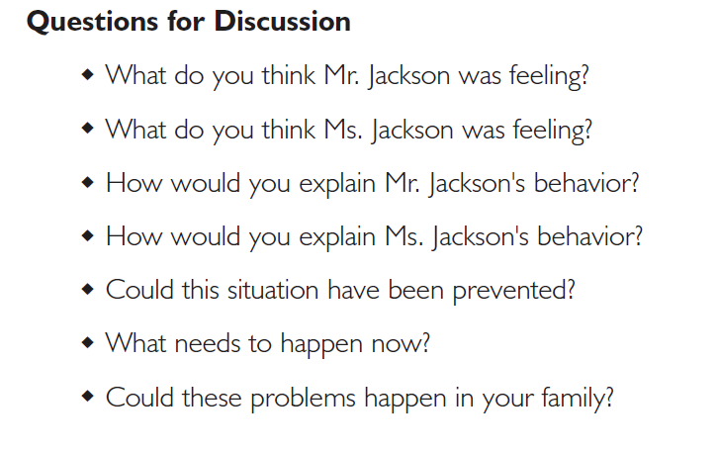

Slide 39
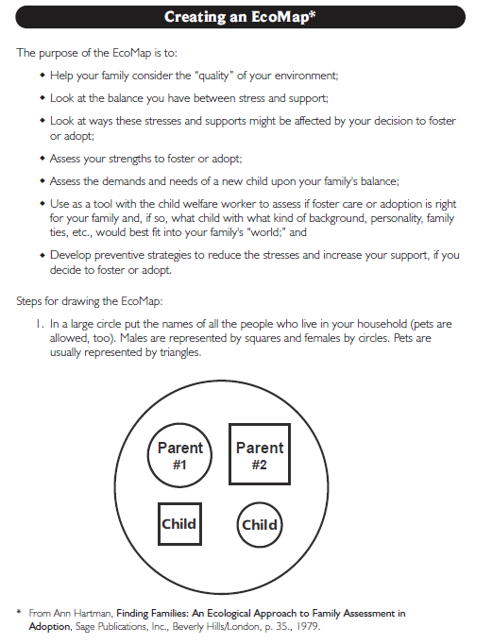
Let’s look at: Handout 9

Slide 40
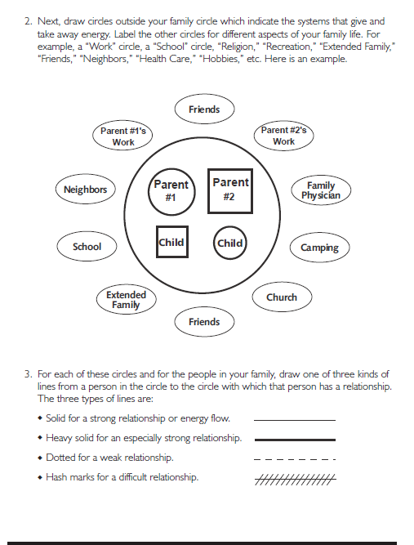

Slide 41
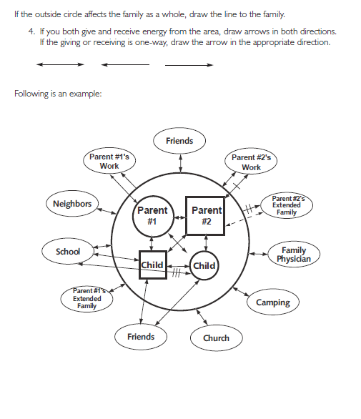

Slide 42
Leader’s EcoMap
Placeholder…

Slide 43
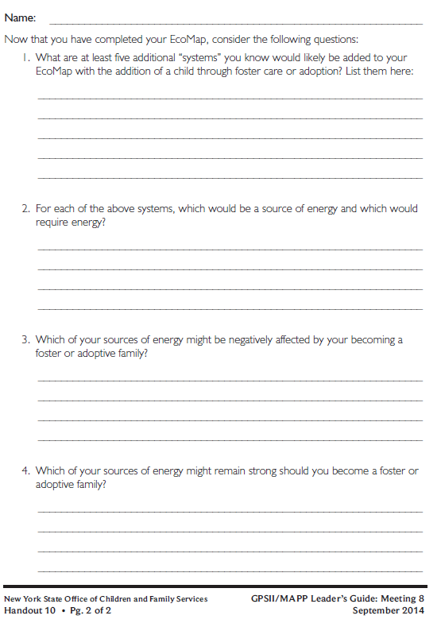
Roadwork: Handout 10, Creating an EcoMap Worksheet

Slide 44
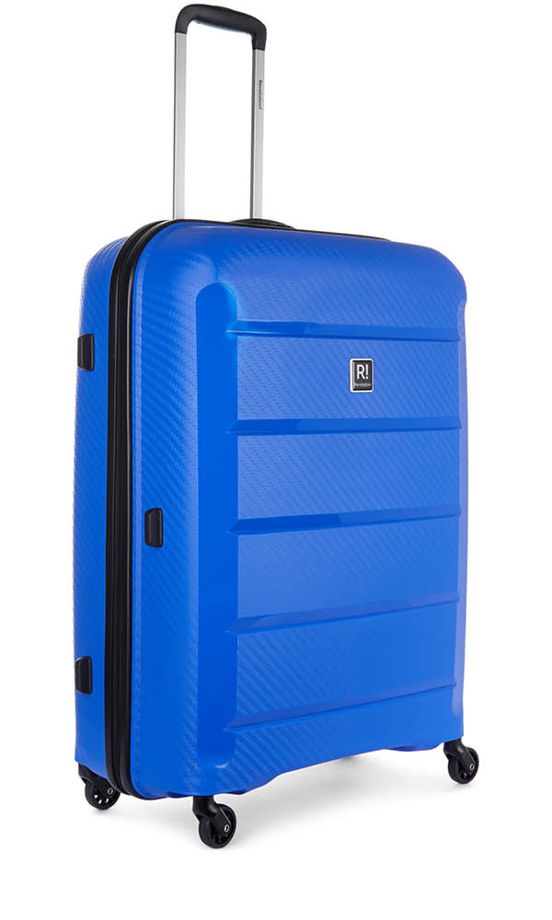
What the Child Brings

Slide 45
What the Child Brings
Fears

Slide 46
What the Child Brings
I come from a home where there was domestic violence. I want to sleep with my baseball bat next to my bed. I feel the need to protect myself.

Slide 47
What the Child Brings
Values

Slide 48
What the Child Brings
I believe that when you see something you want, take it.

Slide 49
What the Child Brings
Culture

Slide 50
What the Child Brings
My culture/religion is Judaism and when I watch everyone celebrating Christmas it makes me feel sad and excluded. I miss my family.

Slide 51
What the Child Brings
Habits

Slide 52
What the Child Brings
I fart all the time, loudly. I fart at the dinner table, when guests are over, and in public. When you tell me to stop, I laugh and say, I can’t help it.

Slide 53
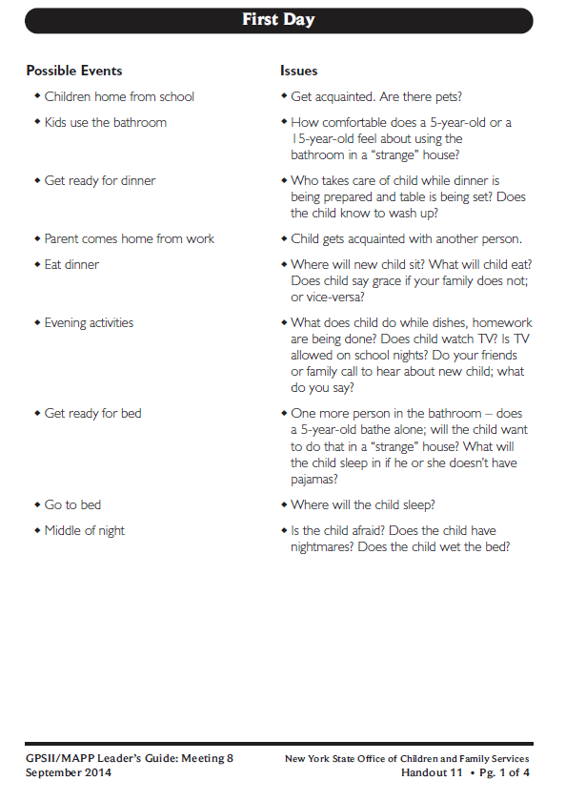
Roadwork: Handout 11, First Day

Slide 54
Twelve Skills for Successful Fostering and Adopting
Know your family
Communicate effectively
Know the children
Build strengths, meet needs
Work in partnership
Be loss and attachment experts
Manage behaviors
Build connections
Build self-esteem
10. Assure health and safety
Assess impact
Make an informed decision

Slide 55
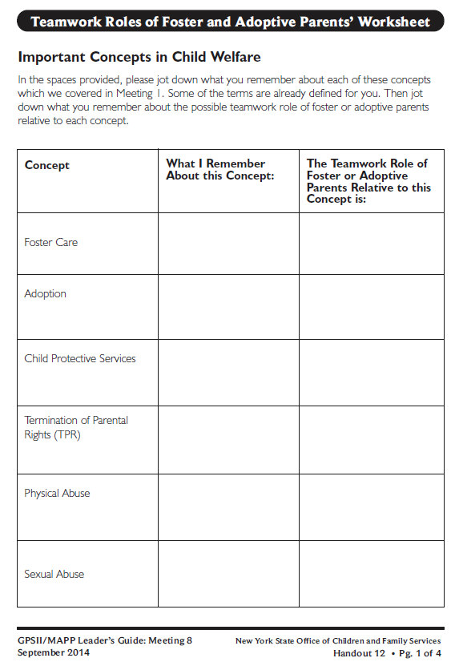
Roadwork: Handout 12, Teamwork Roles of Foster and Adoptive Parents’ Worksheet

Slide 56
Example:
Temporary care for children who can’t live with their family right now
To keep the children safe and to help them return home
If the concept is not familiar to you, leave it blank.

Slide 57
Roadwork
Review all the handouts
Complete Handout 10, “Creating an EcoMap-Worksheet”
Complete Handout 11, “First Day”
Complete Handout 12, “Teamwork Roles of Foster and Adoptive Parents Worksheet,” and bring to Meeting 9

Slide 58
It’s Time for a PIP!
Partnership
In
Parenting Experience

